Slide 1
ENPM685: Information Security Tools
Kevin Shivers
Spring 2022

Slide 2
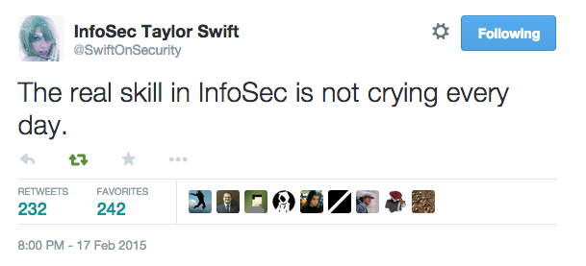
https://twitter.com/SwiftOnSecurity/status/567851173547401216

Slide 3
Who are you?
Who do you want to become?

Slide 4

Who am I?
Deputy Chief Information Security Officer, UMD
Not a doctor (but I have played one for a pen-test)
20+ years of experience in InfoSec
Alum of Sourcefire and McAfee

Slide 5
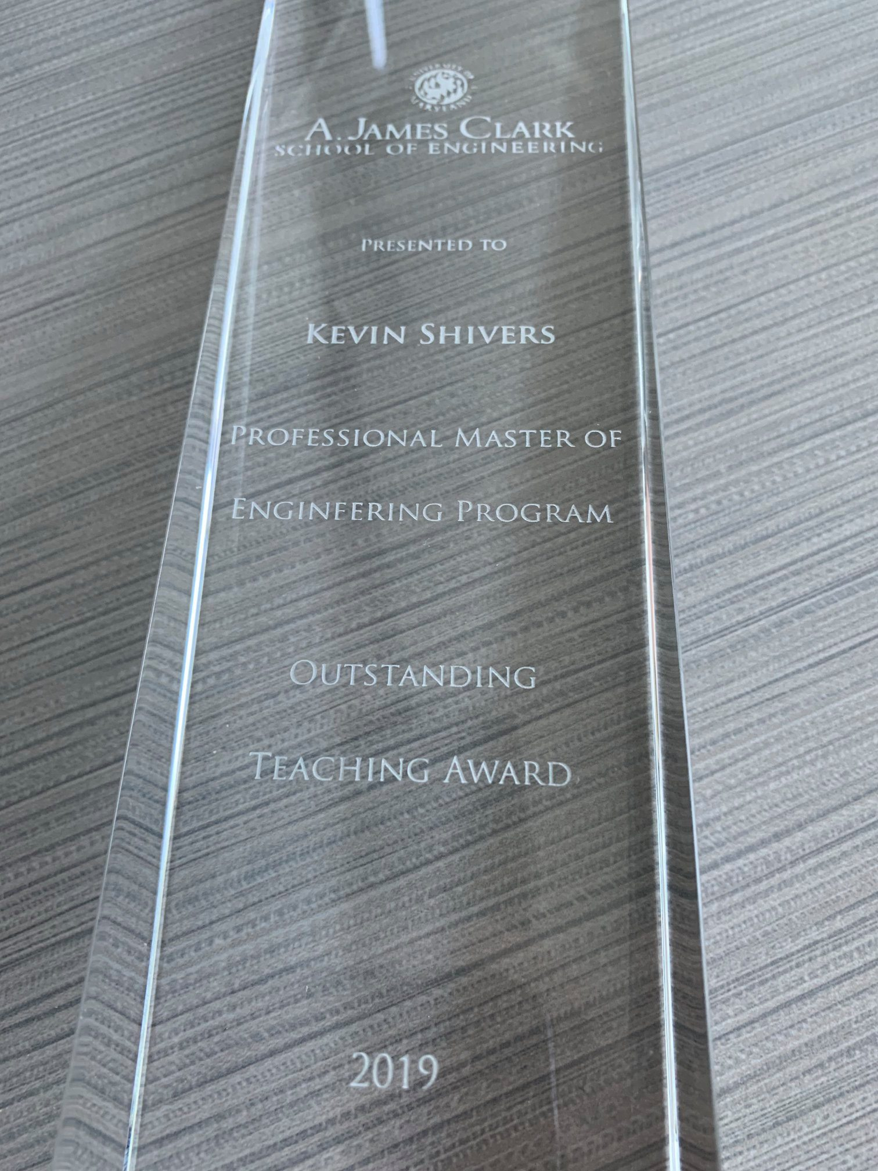
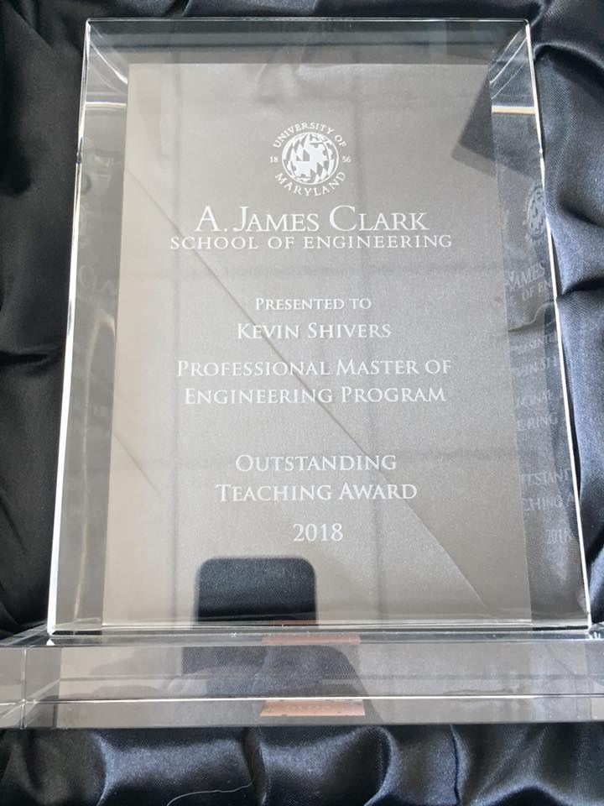
#humblebrag

Slide 6
Your TA
Derek Yhang
dzhang21@umd.edu
Office Hours: TBD

Slide 7


Slide 8
For those playing the home game…
Have the slides/tools as the primary focus when watching live/on demand recordings.

Slide 9
Office Hours
Mondays 11:30am – 1pm
Also by appointment
Virtually through Zoom – See the Zoom tab in ELMS

Slide 10
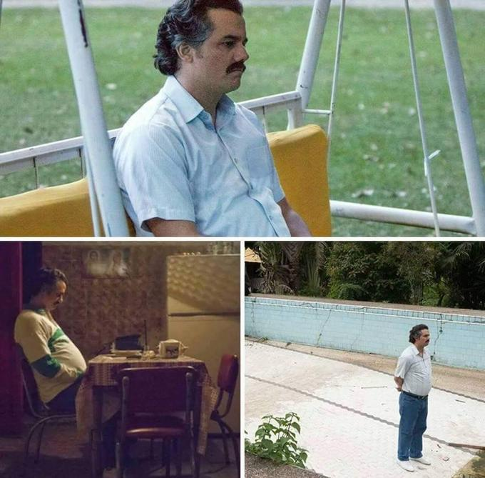

Slide 11
Contact Info
kts@umd.edu
Please put “ENPM685” in the subject line so it doesn’t get lost in the mess that is my inbox

Slide 12
Immigration/Visa Questions?
I can not answer these for you.
Contact ISSS - https://globalmaryland.umd.edu/offices/international-students-scholar-services or an immigration attorney

Slide 13
Technical Questions
Google
TA – Derek Zhang
Myself

Slide 14
Grading
Homework (7 x 5%) = 35%
Midterm Project = 30%
Final Project = 35%

Slide 15
+/- Grading
It’s University Policy (if a little silly IMHO)
A+ = 100 – 99 | B+ = 89.99 – 89 | C+ = 79.99 – 79 | D+ = 69.99 – 69
A = 98.99 – 90.01 | B = 88.99 – 80.01 | C = 78.99 – 70.01 | D = 68.99 – 60.01 | F = 59.99 – 0
A- = 90 | B- = 80 | C- = 70 | D- = 60

Slide 16
Grading
Do the work and you’ll do fine.
If you have don’t understand something or have concerns speak up/reach out as soon as possible!

Slide 17
Late Assignment Policy
An assignment is not complete until it has been submitted in ELMS.

Slide 18
Late Assignment Policy
The only timestamp that matters is the one in ELMS

Slide 19
Late Assignment Policy
Check that you submitted the correct assignment after you have uploaded it!

Slide 20
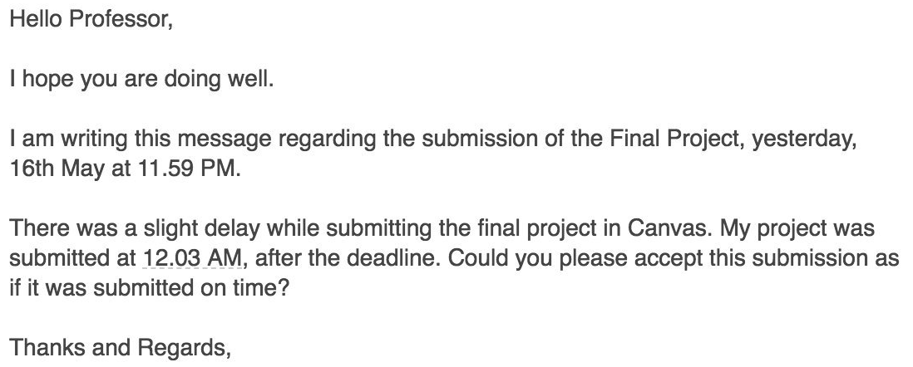
LATE IS LATE

Slide 21
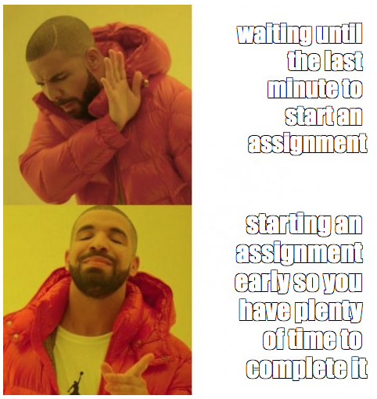

Slide 22
Grade Disputes
TAs and I have on (rare) occasions been known to make mistakes.
If you spot an mistake in your grades contact me via e-mail and we’ll get it resolved.
Note that if I review an assignment for grading mistakes I will conduct a complete regrade, your resulting grade may be higher or lower.

Slide 23
Notice
If you didn’t do the assignment, admit it.
If you submitted the assignment late, admit it.
If you don’t understand the assignment, ask for help.
If you didn’t study or put any effort into the assignment accept the grade and resolve to do better (with my help if needed) next time.

Slide 24
Notice
This is not a democracy.
This is my class.
I am here to teach you and to help you grow.
I can’t learn for you, you have to take responsibility for your own education.

Slide 25
Notice
NO WHINING

Slide 26
No Whining Policy
If you come to me with a silly issue (points taken off for late assignments, typos/sloppy work, etc.) and continue to complain/beg for points I will ask you to stop and warn if you continue to whine I will remove additional points.
YOU HAVE BEEN WARNED.

Slide 27
Homework
There are 7 assignments. You will have at least 1 week to complete them. I will give a time estimate in each assignment on how long I believe it will take you to complete.
Don’t wait until the last minute and use your time wisely.

Slide 28
Midterm Project – Capture the Flag
You’ll be provided one or more virtual machines as part of a penetration testing exercise where you will demonstrate your knowledge of using a number of security tools.
Find the “flags” and submit a write up of your findings.

Slide 29
Final Project – Incident Investigation
This will be a project where you will analyze logs and/or network traffic of a system compromise and write a short paper on the “attack narrative” of how the attacker got into the system and what, if anything, was accessed.

Slide 30
Class Participation
Bring your experiences to the group
Start and engage in class discussions (in class or in ELMS.)

Slide 31
Late Assignment Policy
Late assignments will have 10% of the points deducted for every day the assignment is late.
ex. You turn in a “5” it gets a “4.5”
Assignments submitted over one week late will not be accepted or graded.
aka you get a zero.
If there are extenuating circumstances for you to submit work late please contact me as soon as possible (preferably before the assignment is due.)

Slide 32
Academic Integrity
The University of Maryland, College Park has a nationally recognized Code of Academic Integrity. This Code sets standards for academic integrity at Maryland for all undergraduate and graduate students. As a student you are responsible for upholding these standards for this course. It is very important for you to be aware of the consequences of cheating, fabrication, facilitation, and plagiarism. For more information on the Code of Academic Integrity or the Student Honor Council, please visit http://www.shc.umd.edu

Slide 33
Honor Pledge
All assignments and exams for this course are governed by the Honor Pledge: “I pledge on my honor that I have not given or received any unauthorized assistance on this exam/assignment.”

Slide 34
Plagiarism
DON’T
DO
IT

Slide 35
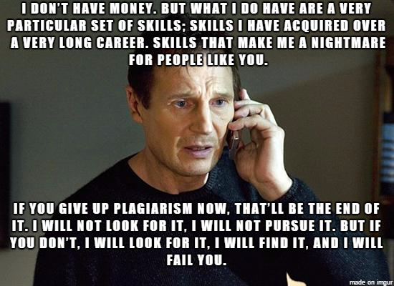

Slide 36
Asking for help
Asking a fellow student for help understanding a concept is OK
Asking a student to help you with an answer to a homework assignment or project IS NOT OK.
If you are asked for answers to an assignment DO NOT provide them.
If you need help with a concept or how to do something ASK!
Email the TA or instructor
Attend office hours

Slide 37
Plagiarism. Don’t do it.
The practice of taking someone else's work or ideas and passing them off as one's own.
This includes getting a friend/classmate to give you the answers to an assignment and using them.
Helpful infographic: http://thevisualcommunicationguy.com/wp-content/uploads/2014/09/Infographic_Did-I-Plagiarize1.jpg
If I see it you will get a 0 for the assignment and at my discretion will be reported to the Office of Student Conduct.
Seriously.
Don’t be that person.
Seriously.

Slide 38
Which one is correct?
ip address
IP address
Ip address
I.p. address
I.P. address

Slide 39
PROOFREAD YOUR WORK
If there are typos or egregious grammatical errors in your work you will not receive full points for the assignment.

Slide 40
PROOFREAD YOUR WORK
I am preparing you for taking the next step in the real world and part of that is demonstrating and projecting that you know what you are talking about.
Typos and egregious grammatical errors do not inspire confidence in your level of competence.

Slide 41
Why am I harping on this?
“The one easy way to become worth 50 percent more than you are now — at least — is to hone your communication skills — both written and verbal…" -- Warren Buffett
https://www.cnbc.com/2018/12/05/warren-buffett-how-to-increase-your-worth-by-50-percent.html

Slide 42
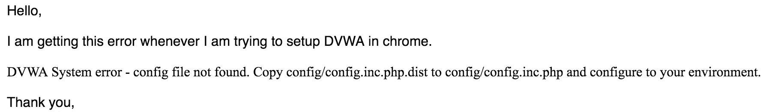

Troubleshooting

Slide 43
Recommended Textbooks
If you’re new to Python I highly recommend Automate the Boring Stuff with Python, 2nd edition
Online: https://automatetheboringstuff.com/
eBook and print copies available too. Very handy!

Slide 44
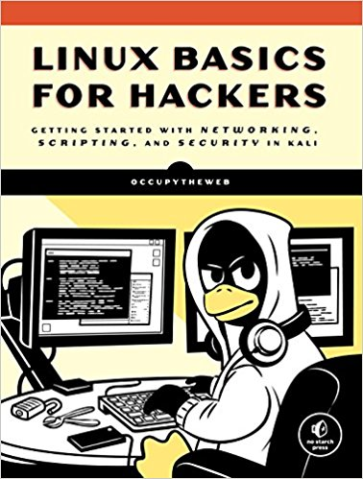
Recommended Textbooks
If you’re new to Linux – Linux Basics for Hackers shows promise. (I have not read it but it looks like it covers the basics.)

Slide 45
Course Layout
Week 1 – Intro, VMs, Windows, Linux
Week 2 – Anatomy of an Attack
Week 3 – Offense: Vulnerability Assessment
Week 4 – Offense: Penetration testing tools
Week 5 – Offense: Penetration testing tools
Week 6 – Scripting with Python
Week 7 – Scripting with Python
Week 8 – Defense in Depth: Network Analysis Tools
Week 9 – SPRING BREAK!

Slide 46
Course Layout
Midterm due – Monday March 28th
Week 10 – Defense in Depth: Firewalls
Week 11 – Defense in Depth: Intrusion Detection/Prevention
Week 12 – Defense in Depth: Incident Response and Investigation tools
Week 13 – Defense in Depth: Incident Response and Investigation tools
Week 14 – Defense in Depth: Incident Response and Investigation tools
Week 15 – Course Wrap up
Final due – Monday May 16th

Slide 47
What won’t we get into?
Forensics/eDiscovery - See ENPM687
Reverse Engineering tools – See ENPM696
Software testing– See ENPM697
Deeper dive into penetration testing tools – See ENPM634
Audit/GRC tools

Slide 48
Feedback is a Gift
Please let me know if you find something lacking or have specific tools you’d like to see included

Slide 49
Words of Warning
We will play with potentially dangerous tools in here. (You can shoot your eye out.)
Please keep your hands to yourself whether here, work or at home.
I’m NOT indemnifying you for anything you might do.

Slide 50
Safe Hacking
Make sure you have permission to hack whatever you’re trying to hack
Written permission is best (Get out of jail free card)
Always protect yourself

Slide 51
Class Requirements
A computer with 8GB of RAM (16GB+ preferred) and ~120GB of free disk space capable of running x86-based virtual machines
A copy of VMWare (free from https://terpware.umd.edu/)
The provided virtual machines

Slide 52
Class Google Drive space
https://drive.google.com/drive/folders/1RwN9aWwpNoVXFY4ATiWBdk6bjne4qNyZ?usp=sharing
Virtual Machines, Readings, Exercise/Homework/Midterm/Final documentation will be posted here (link is also in ELMS)

Slide 53
The VMs
Ubuntu Linux – download from ubuntu.org
Kali Linux – download from kali.org
Metasploitable 3 – class link (x86 only)
Feel free to create and add extras.

Slide 54
VM Networking
Leave the network as NAT (“Internet Sharing”)
If you change this bad things will happen to you

Slide 55
Homework #1
Download & install VMware
Build/import class virtual machines
Verify that VMs work
Deliverable: screen shots of your running VMs
Due 2/5 @ 11:59pm

Slide 56
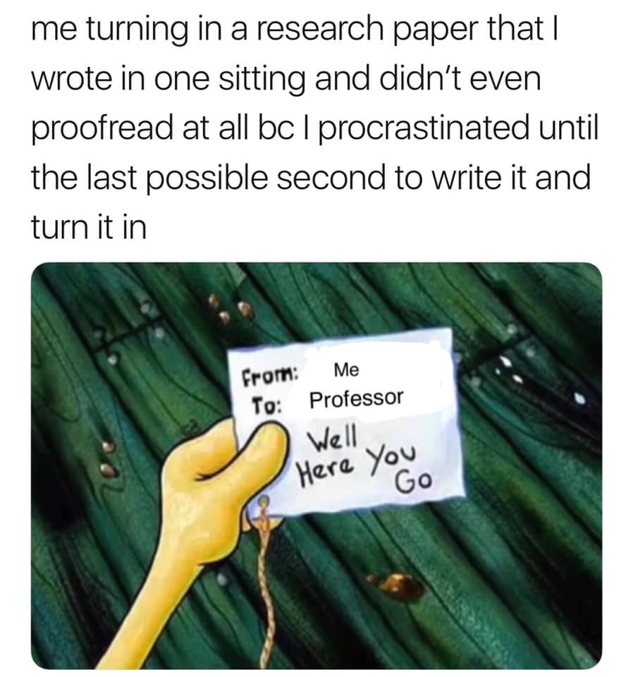
Time Management 101

Slide 57
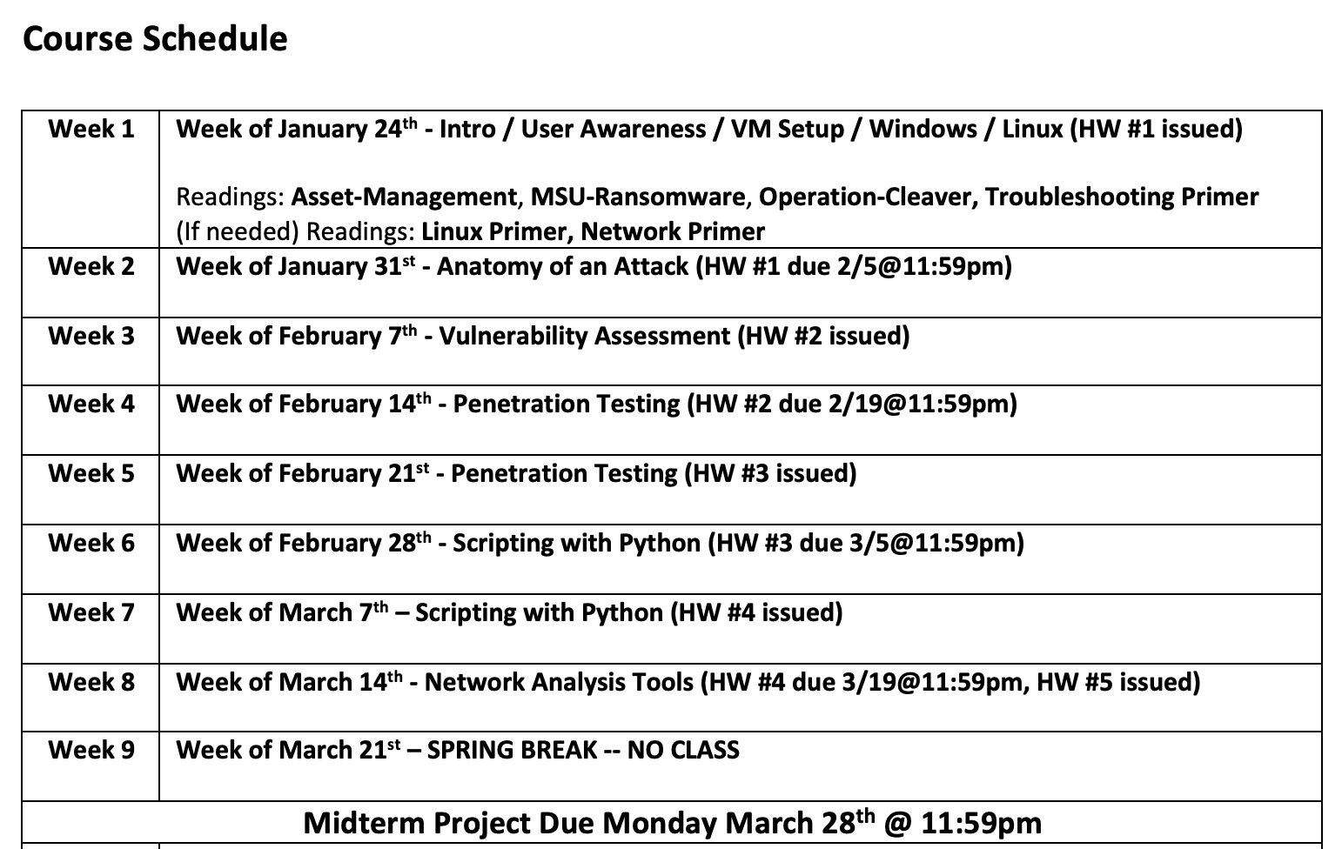

Slide 58
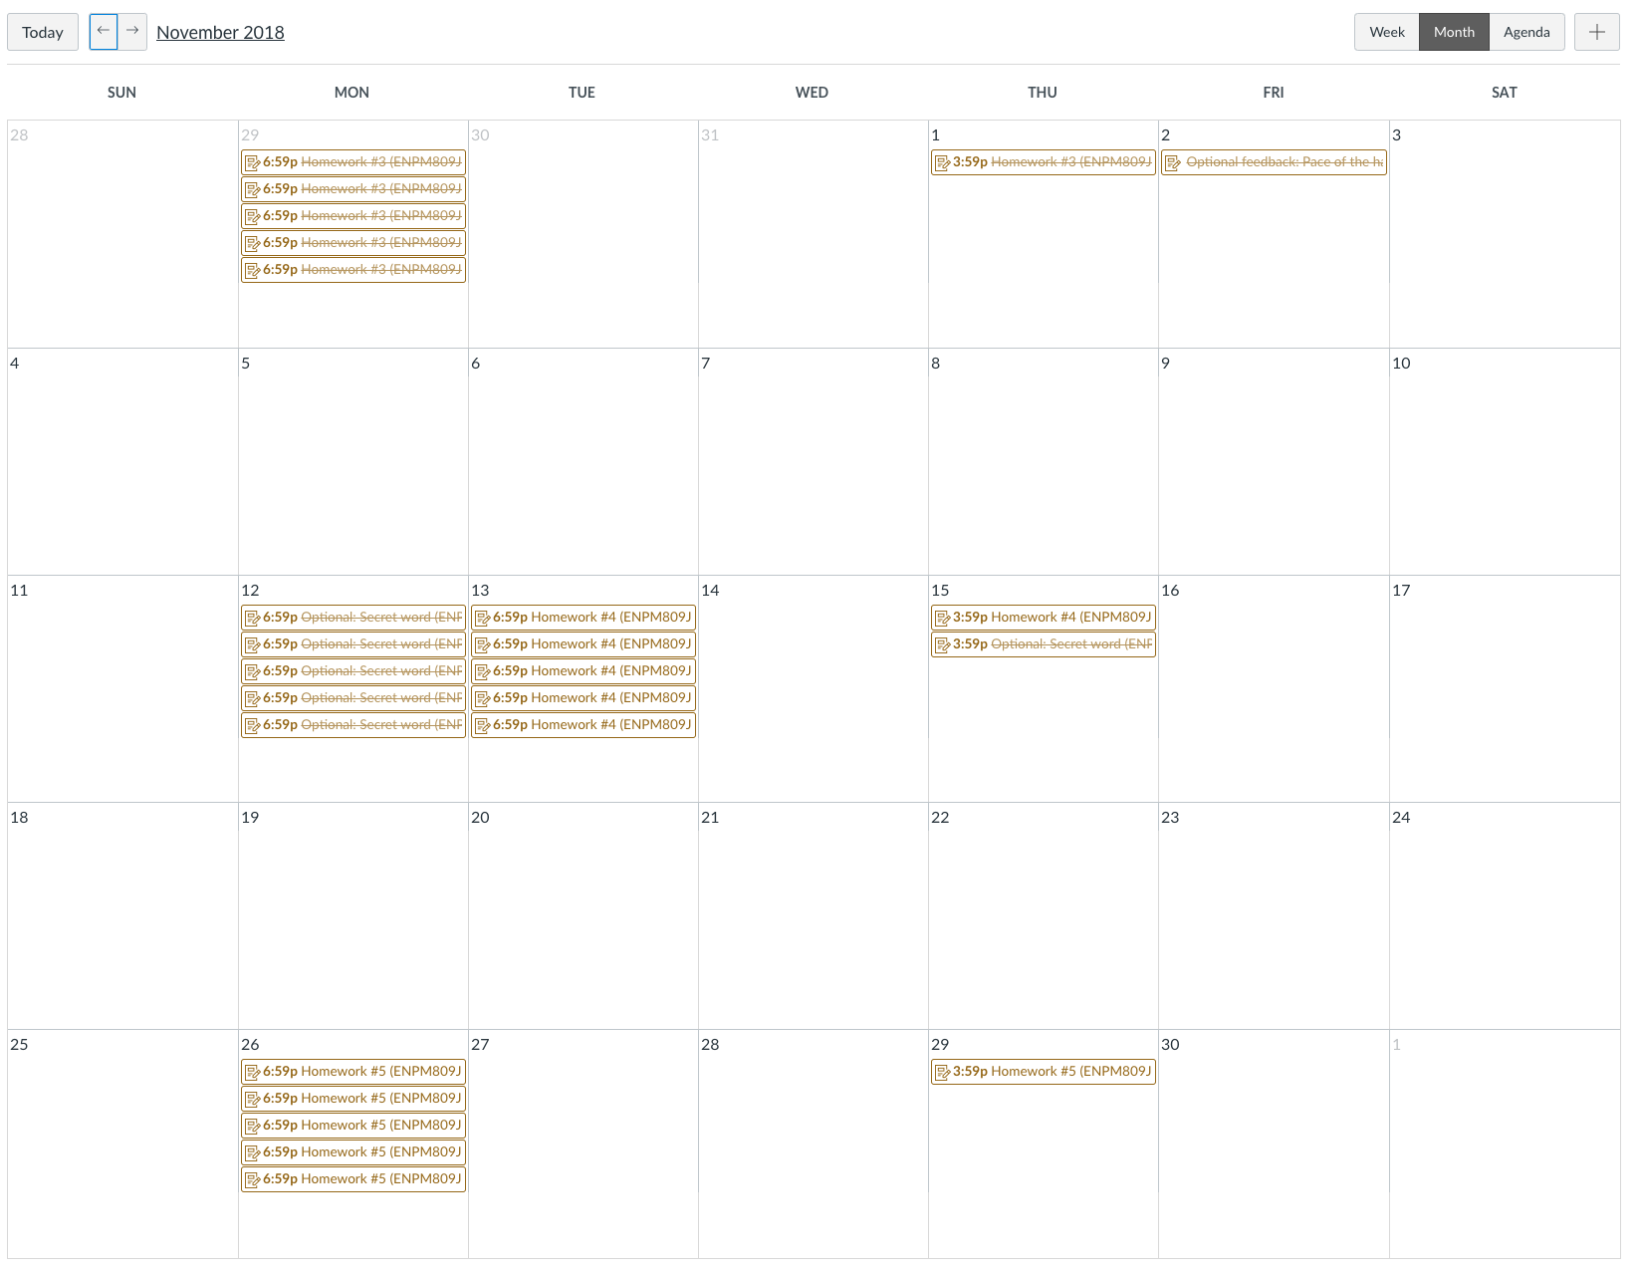
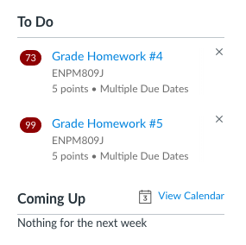
In ELMS

Slide 59
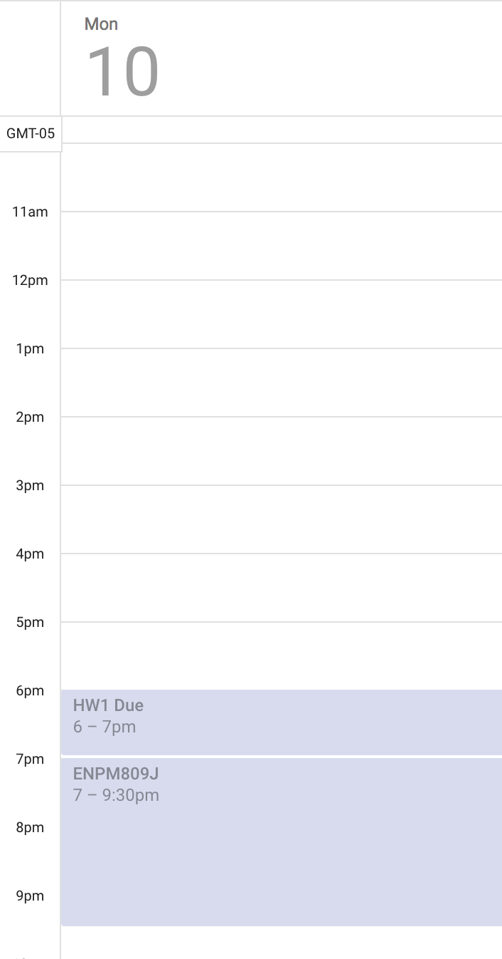
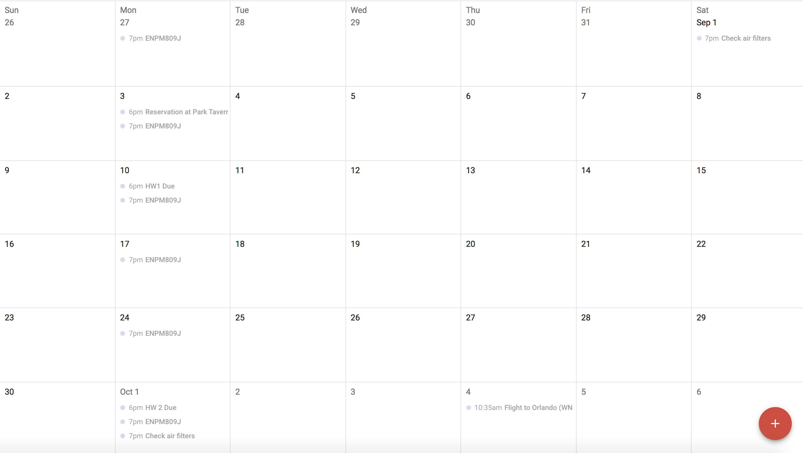

Slide 60
Build your calendar
1/26 – Start of class, HW1 issued
2/5 – HW 1 due,
2/9 – HW2 issued
2/19 – HW 2 due
2/23 – HW 3 issued, Midterm issued
…

Slide 61
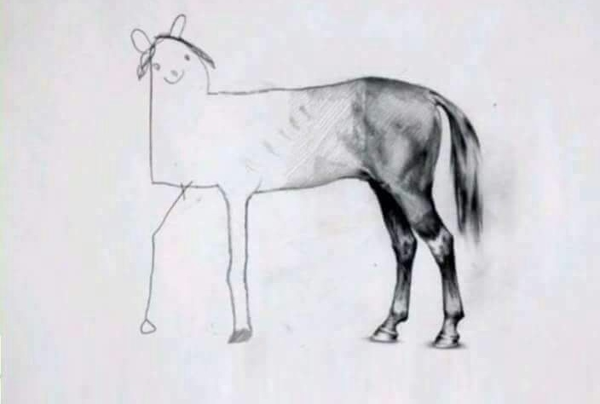
Don’t let your assignments look like this

Slide 62
How I’d Do an Assignment
You have 1 week to complete an assignment
Night of – review the assignment – how much time will this take me? The professor has included a time estimate, how close is that for me?
Day after class – begin/complete assignment
2 Nights before it’s due – review/upload assignment

Slide 63
How I’d Do a Project
Project assigned: 2/23
Review and begin work: 2/24 – 2/25
Develop outline
Draft complete: 3/7 – 3/11
Completed, night off to review: 3/18
Submit it by: 3/19 @11:59pm
Project Due: 3/28 @ 11:59pm

Slide 64
How I’d Do a Project
Completed, night off to review: 3/18
Submit it by: 3/19 @11:59pm
Project Due: 3/28 @ 11:59pm
Why?

Slide 65
Every semester
Review the syllabi for your classes for assignments, exams, projects, etc. and put them on your calendar!
If a syllabus doesn’t list assignments/dates then ask the professor!

Slide 66
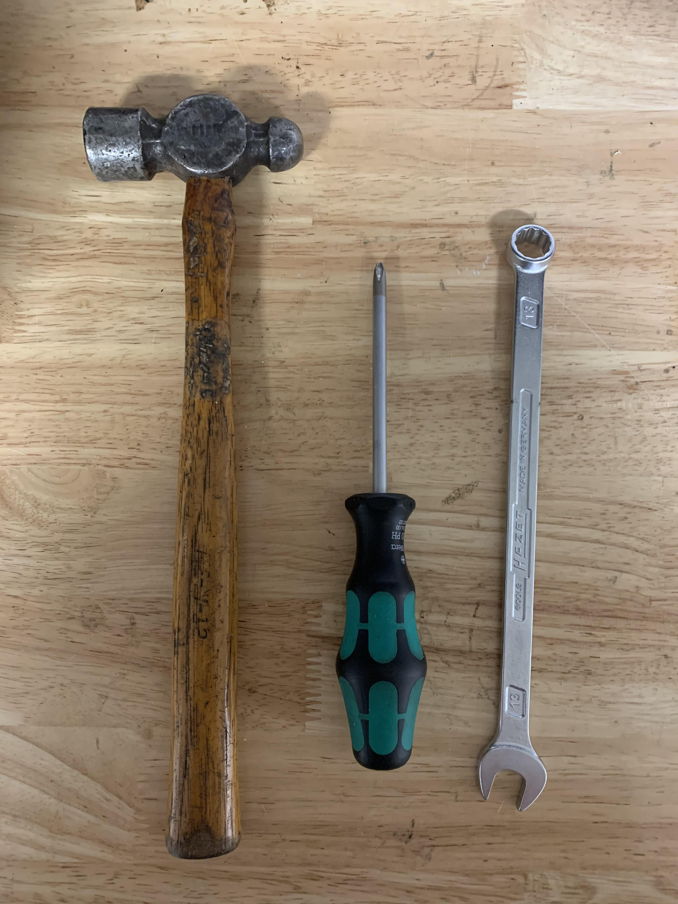
Tools?

Slide 67
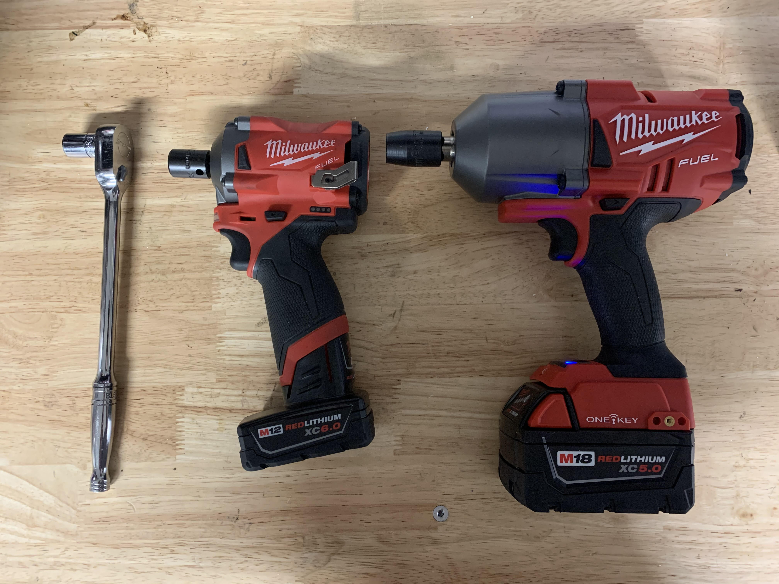

Slide 68
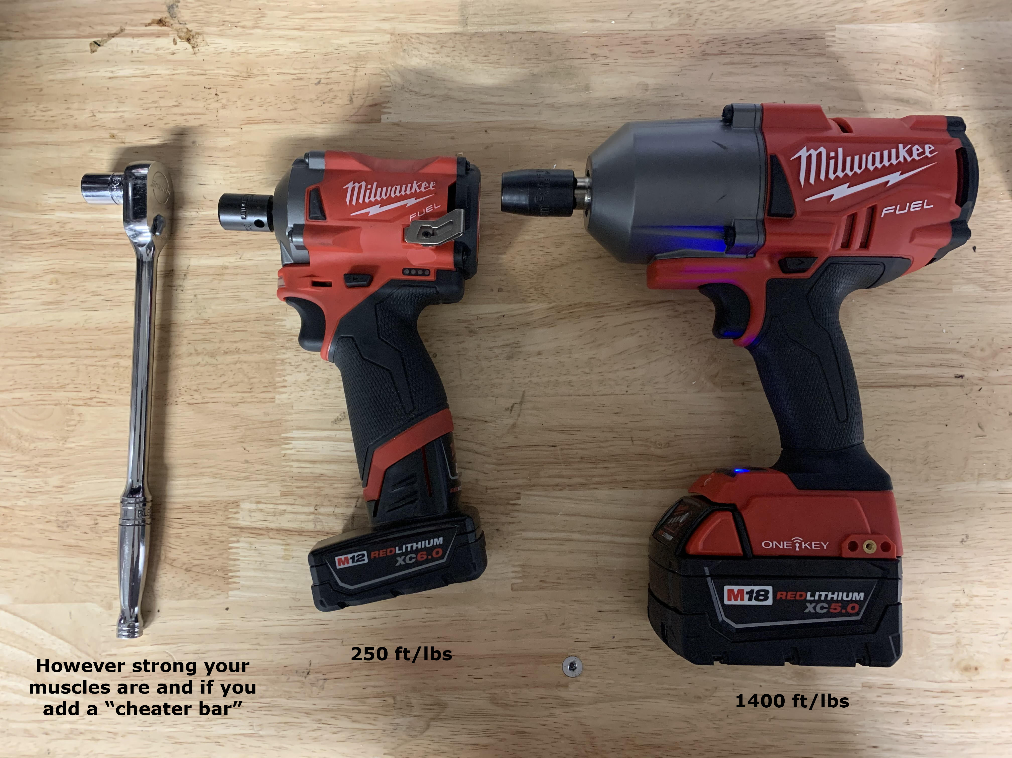

Slide 69
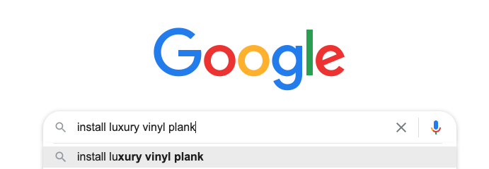
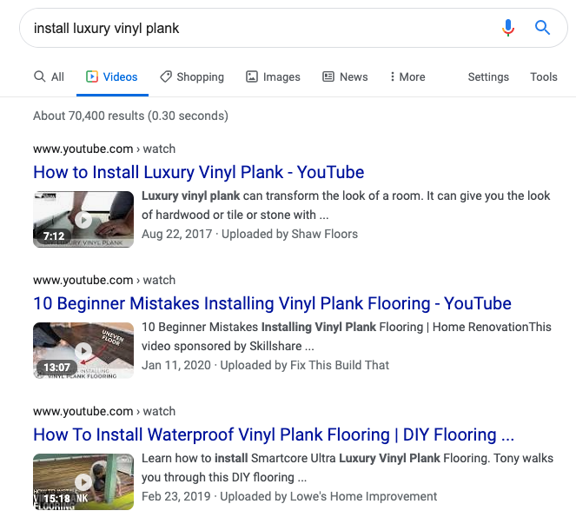
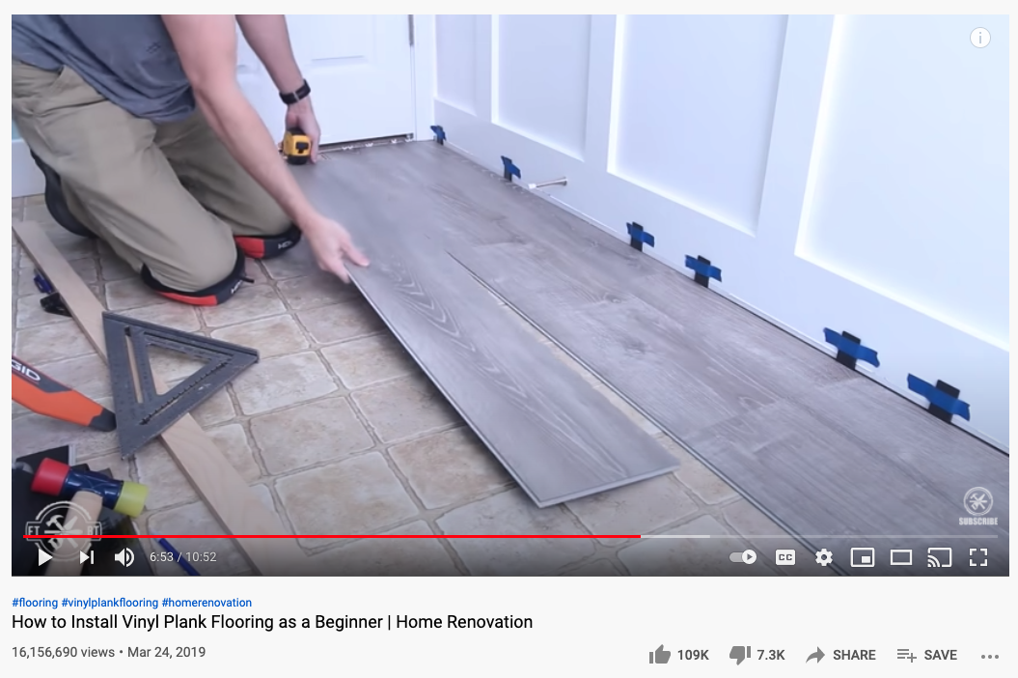

Slide 70
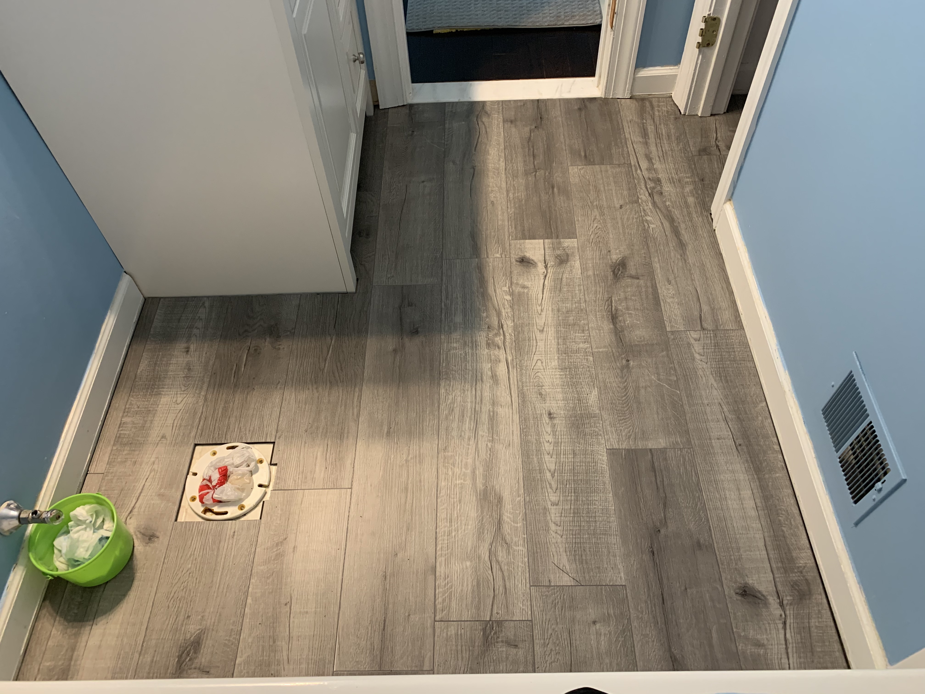
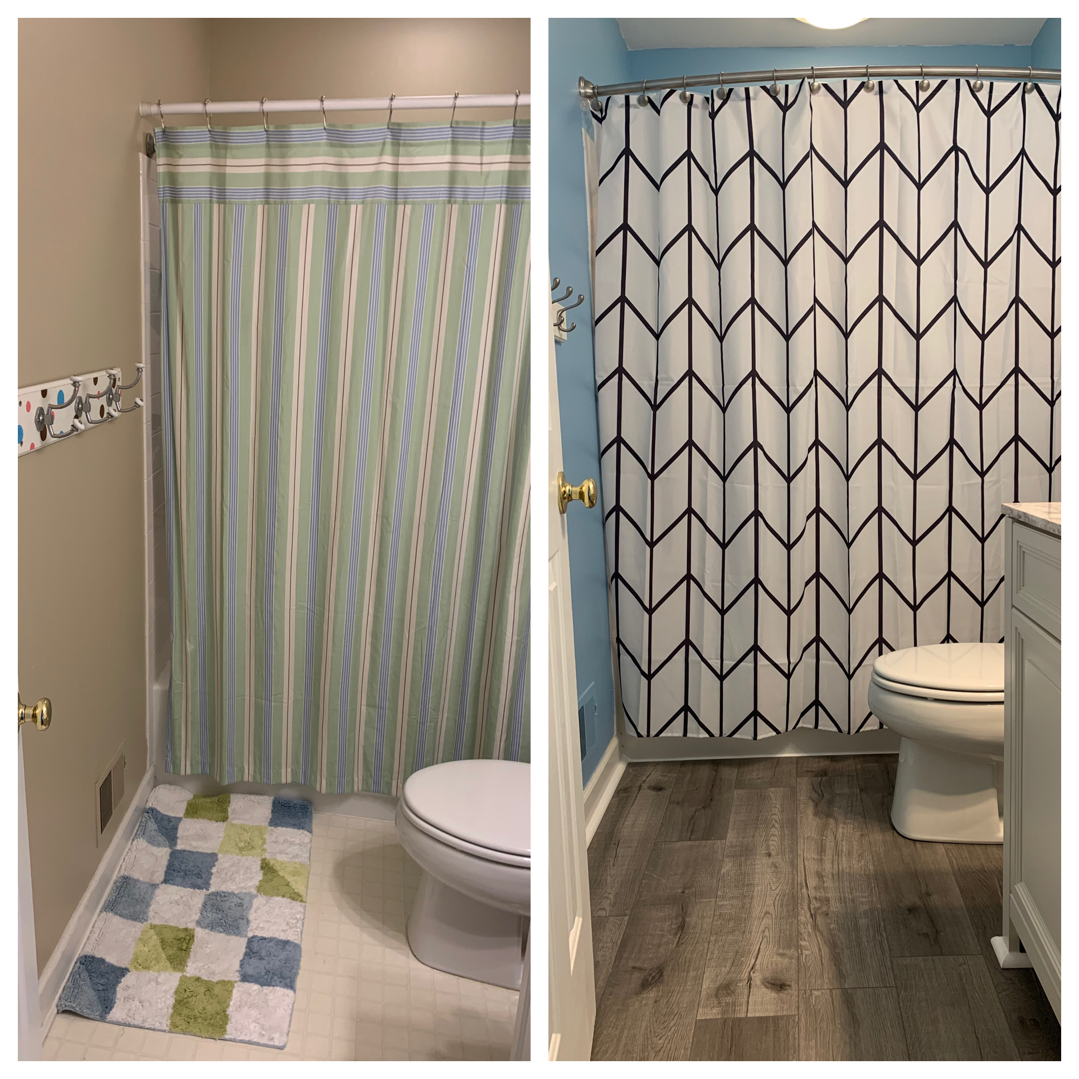

Slide 71
And now for something completely different…

Slide 72
Your Infosec Journey
How did you get into infosec?
What drives you?
Where are you on this journey now?
Where do you want to go?

Slide 73
Why Infosec?
You have the job security of a starting running back in the NFL
aka not much
The hours are often bad
The pay often not enough
Higher ups love to play lip service to you but not actually do anything to improve security posture
When people have to change their password, use MFA, have to use the VPN – they blame you
When people get owned – they blame you (and often it’s your head that rolls)

Slide 74
Why Infosec?
Because it’s interesting
Because you’ll never be bored
Because you love a good mystery
Because you love banging your head against the wall/desk
Because you’ll get to travel to interesting places
Because you’ll get to meet interesting people
Because infosec parties are more fun than other parties

Slide 75
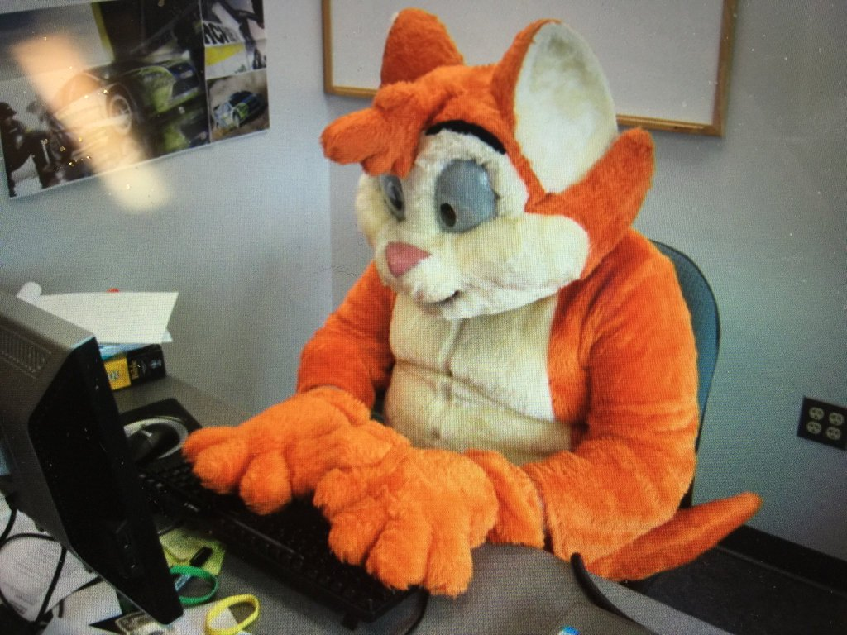
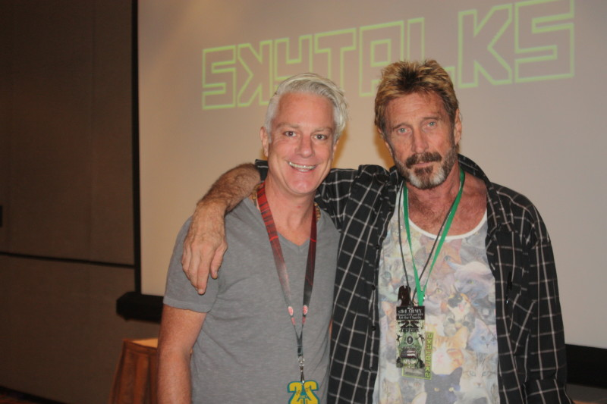
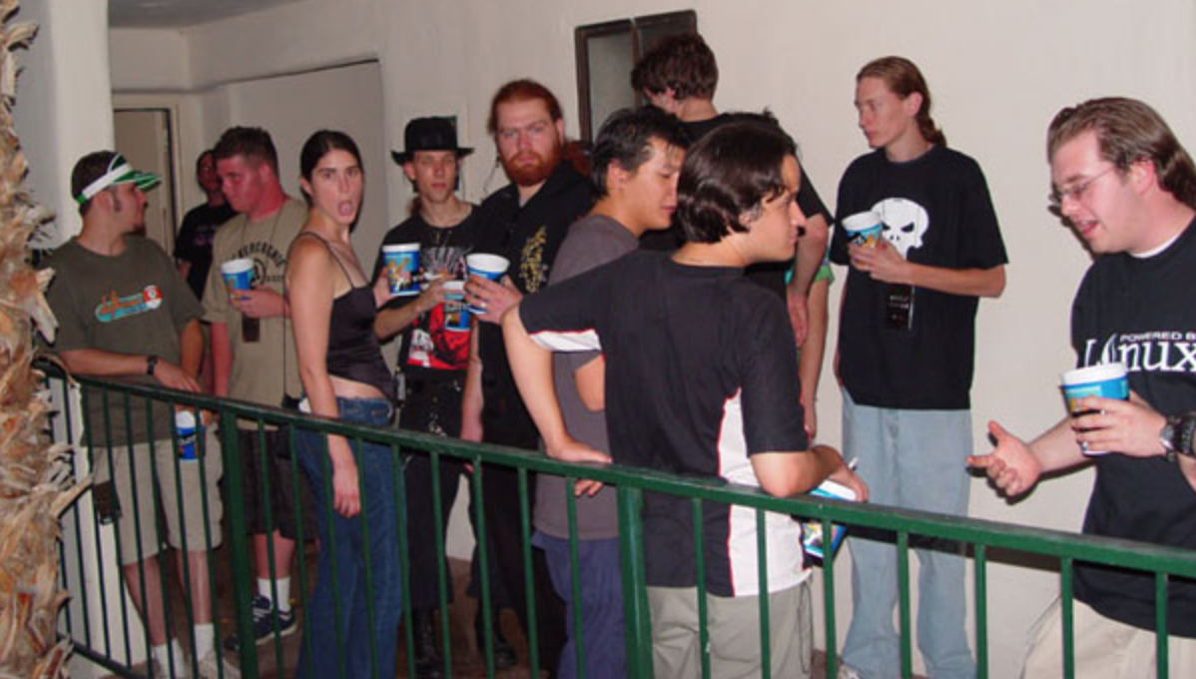
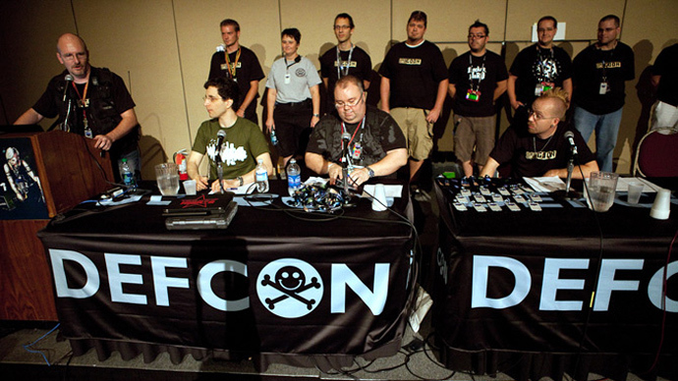

Slide 76
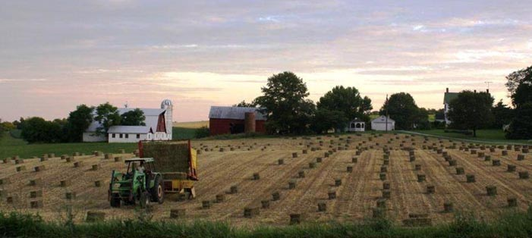
My Infosec Journey

Slide 77
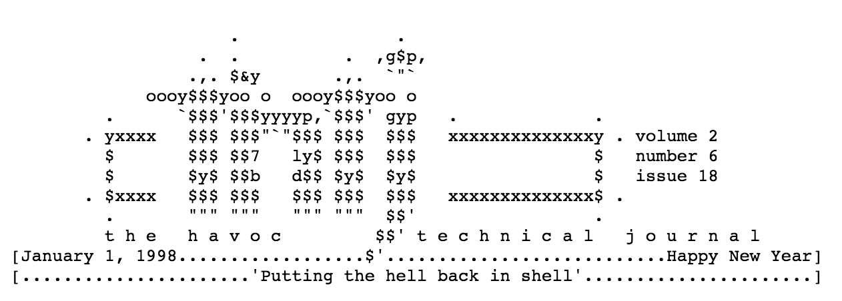

Slide 78
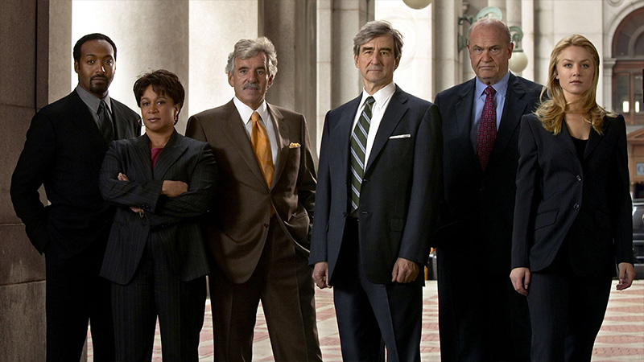

Slide 79


Slide 80


Slide 81


Slide 82


Slide 83
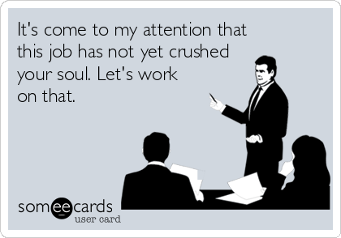

Slide 85


Slide 86
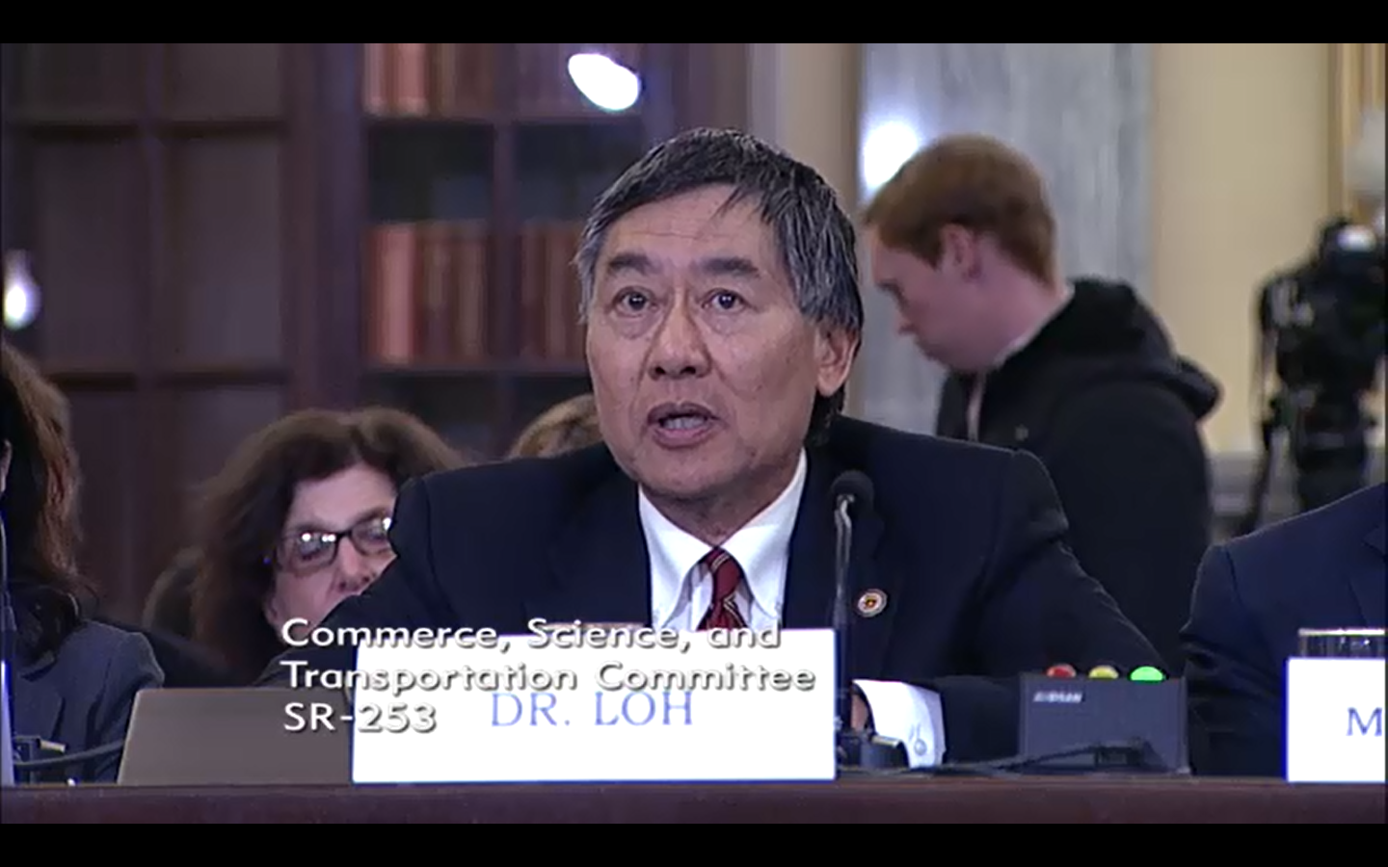

Slide 87
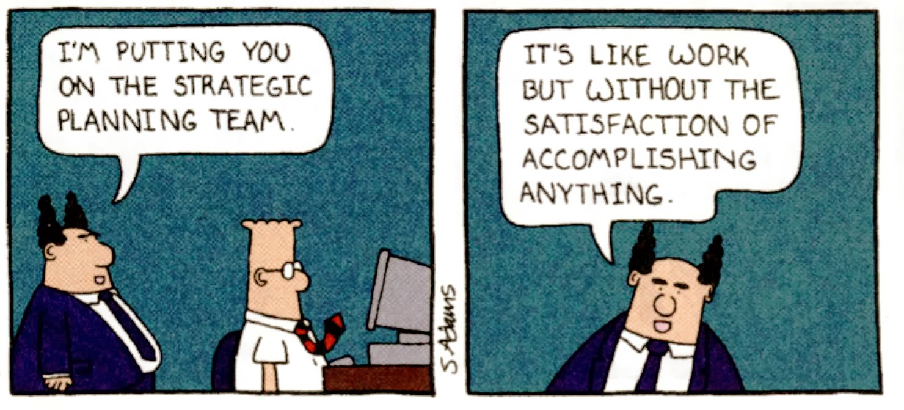

Slide 88
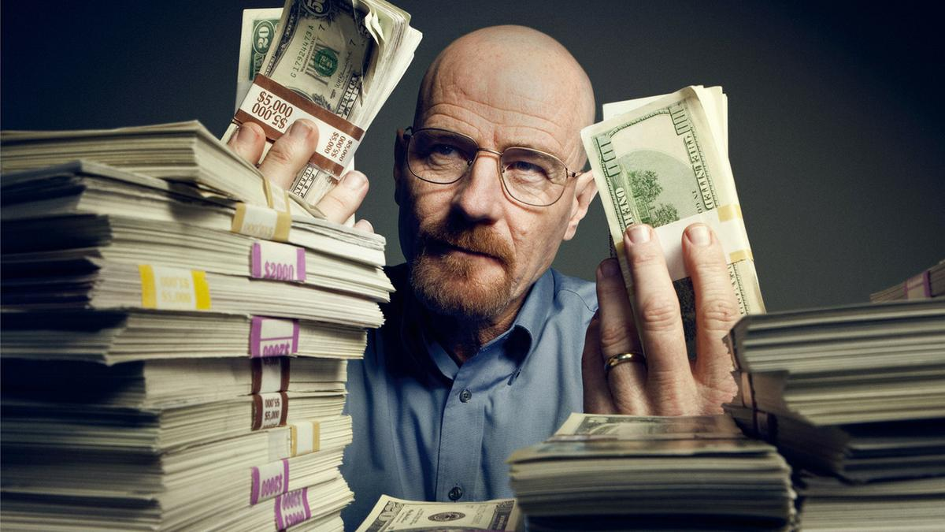
What’s Next?

Slide 89


Slide 90


Slide 91
Your Infosec Journey
If you would like to present your infosec journey (to class, or just to myself) email kts@umd.edu and put “ENPM685 Infosec Journey” in the title
The media format for this is open

Slide 92
More on Starting an Infosec Career
https://danielmiessler.com/blog/build-successful-infosec-career/
https://tisiphone.net/2015/10/12/starting-an-infosec-career-the-megamix-chapters-1-3/
* more on this topic soon

Slide 93
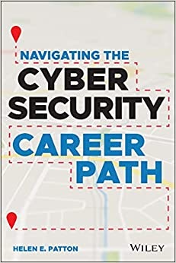
More on Starting an Infosec Career
Patton, H. Navigating the Cybersecurity Career Path, Wiley, 2021. ISBN: 978-1119833420
https://www.amazon.com/Navigating-Cybersecurity-Career-Path-Insider/dp/1119833426/

Slide 94
The Best Tool Out There
Is a well trained and informed user.

Slide 95
User as a Entry Point
Website visits (watering hole attack)
BYOD
BYO software/OS/USB key
Bribing the cleaners + implants (Evil maid attack)
Social Engineering
Phishing/Spear Phishing

Slide 96
NEVER UNDERESTIMATE A USER’S ABILITY TO DO SOMETHING BADTM

Slide 97
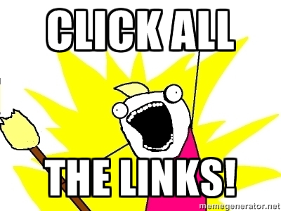

Slide 98
Users – The First & Last Line of Defense
Good security awareness program
Equip them to make good decisions
Make your awareness program mandatory and as pain free as possible
Maybe with some pain if they don’t do it…

Slide 99
Security Awareness Training
SANS Securing The Human
$
https://securingthehuman.sans.org
Cybrary’s End User Awareness Training
Free
https://www.cybrary.it/course/end-user-security-awareness-1-hour/

Slide 100
A Typical User’s Point of View
“If it ain’t broken don’t fix it!”

Slide 101
A Typical User’s Point of View
‘Security Fatigue’ Can Cause Computer Users to Feel Hopeless and Act Recklessly, New Study Suggests
https://www.nist.gov/news-events/news/2016/10/security-fatigue-can-cause-computer-users-feel-hopeless-and-act-recklessly
“I don’t pay any attention to those things anymore…People get weary from being bombarded by ‘watch out for this or watch out for that.’”

Slide 102
A Typical User’s Point of View
“I get tired of remembering my username and passwords.”
“I never remember the PIN numbers, there are too many things for me to remember. It is frustrating to have to remember this useless information.
“It also bothers me when I have to go through more additional security measures to access my things, or get locked out of my own account because I forgot as I accidentally typed in my password incorrectly.”
Participants also wonder why they would be targeted in a cyberattack. The data showed that many interviewees did not feel important enough for anyone to want to take their information, nor did they know anyone who had ever been hacked.

Slide 103
Security Awareness
End user top risks
Phishing
Poor password practice
Not updating software
Not changing default passwords/configuring devices (printers)
Sharing too much on social media
Data loss / not backing up data

Slide 104
Security Awareness - Phishing
Users are being phished all the time, everything from *really* bad attempts to highly cloned emails and sites that look legitimate
Why?
Because it works
Everything from using their email account to send spam, steal $, infect their work/home computer, etc.
Teach them how to identify phishing messages and remind them that the only person who should know their password is them!

Slide 105
Security Awareness – Password Practices
Selecting good passwords
“Be!z28&TRuck” or “thequickbrownfoxjumpsoverthelazydog”
Not “password”
Minimize password reuse, especially between highly sensitive accounts (banking) vs. low sensitivity (internet forum)
Password Managers
Fill out reset questions
Don’t share your password
Don’t write it on a sticky on your keyboard/monitor
Multi Factor Authentication

Slide 106

Security Awareness – Password Practices

Slide 107
Security Awareness – Password Practices
http://www.thegatewaypundit.com/2018/01/hawaiian-emergency-management-officials-hold-interview-post-notes-passwords-computer-screens/
Hawaiian Emergency Management Officials Hold Interview – Post-It Note of password on their monitor

Slide 108
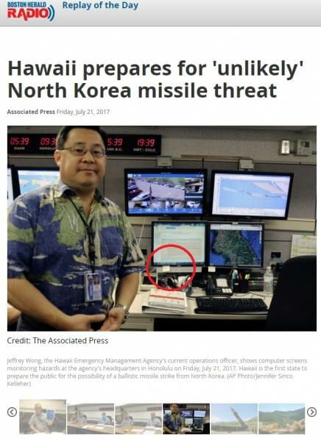
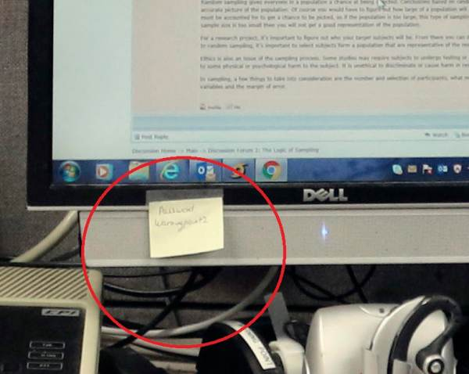
Security Awareness – Password Practices
Password = Warningpoint2

Slide 109
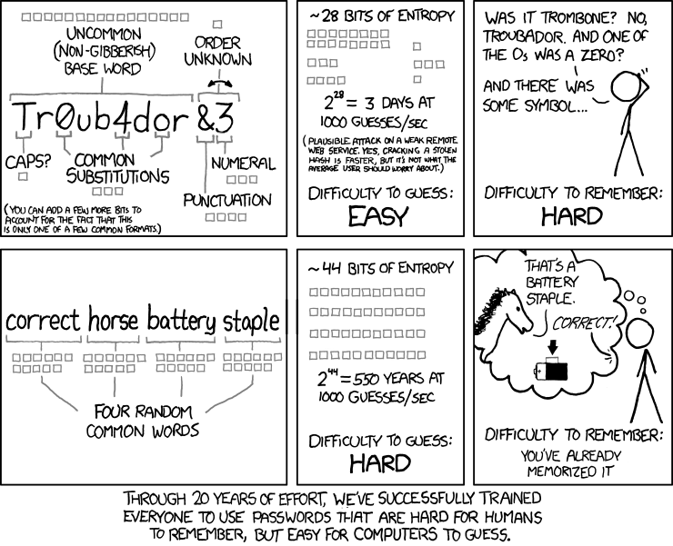
Security Awareness – Password Practices
https://xkcd.com/936/

Slide 110
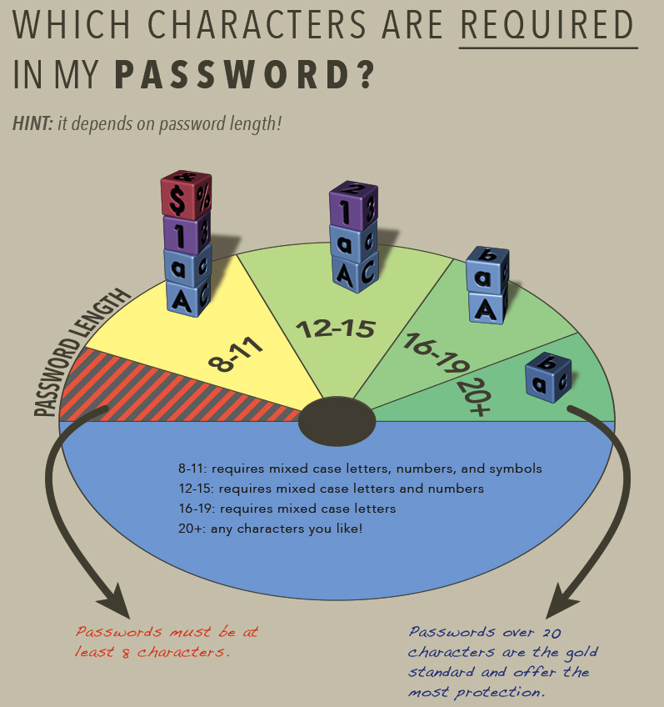
Security Awareness – Password Practices
https://uit.stanford.edu/service/accounts/passwords/quickguide

Slide 111
Security Awareness - Patching
Users need to understand that updating software is not just to add new features, it’s to install important security updates
Set to automatically update if at all possible and/or make as painless as possible
Actually run all those self-updating tools we never do!
Encourage removing packages that are not needed (Flash, Acrobat, Java, Silverlight)
Add a password to your printer/NAS/etc. and turn off anything not needed.

Slide 112
Security Awareness – Social Media
Sharing your entire life on social media is not always a good idea. (I’m looking at you Kim Kardashian…)
Know your whereabouts, likes, who you know, etc.
All very valuable for physical attacks, social engineering, impersonation, password resets, etc

Slide 113

Security Awareness – Social Media

Slide 114
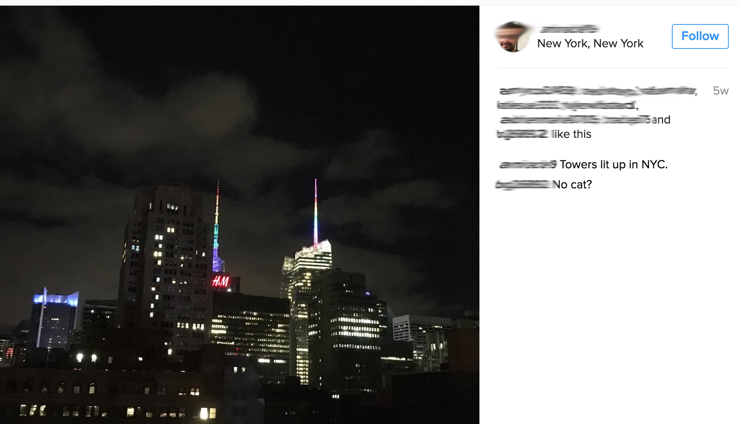
Security Awareness – Social Media

Slide 115
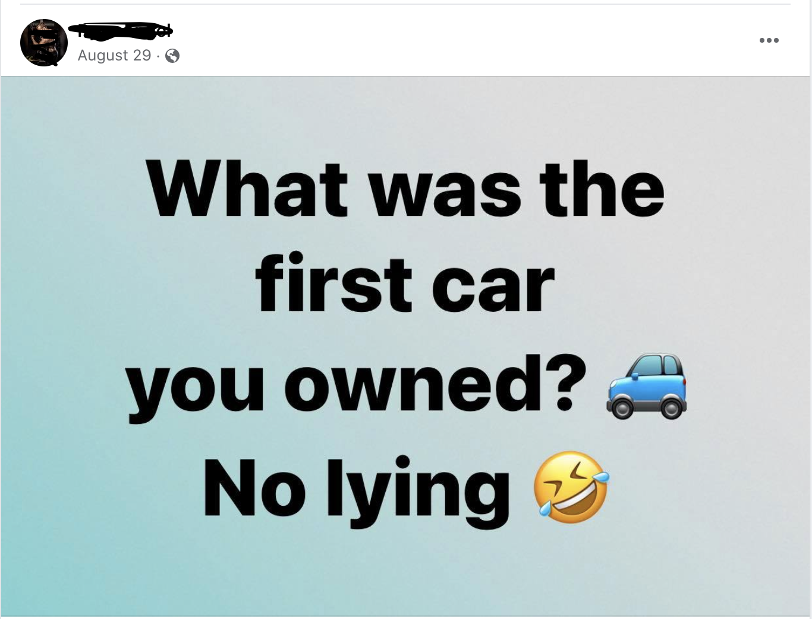
Security Awareness – Social Media

Slide 116
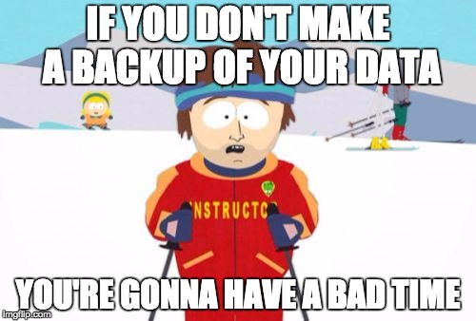
Security Awareness – Data Loss

Slide 117
Security via Policy
Don’t embed links in email
Strong password policy (complexity and frequency of change)
Require VPN usage
Frequent communication between IT and users
^ effective

Slide 118
Keep IT Security Relevant
Consider sending Daily/Weekly/Monthly bulletins
Weekly/Monthly to end users – keep it light, informative, and relevant.
Not just institutional risk but also personal risk
“It’s Tax Fraud Season”
Daily – Opt in/for IT admin and interested users
Automate
Stats/current threats/patches are your friend

Slide 119
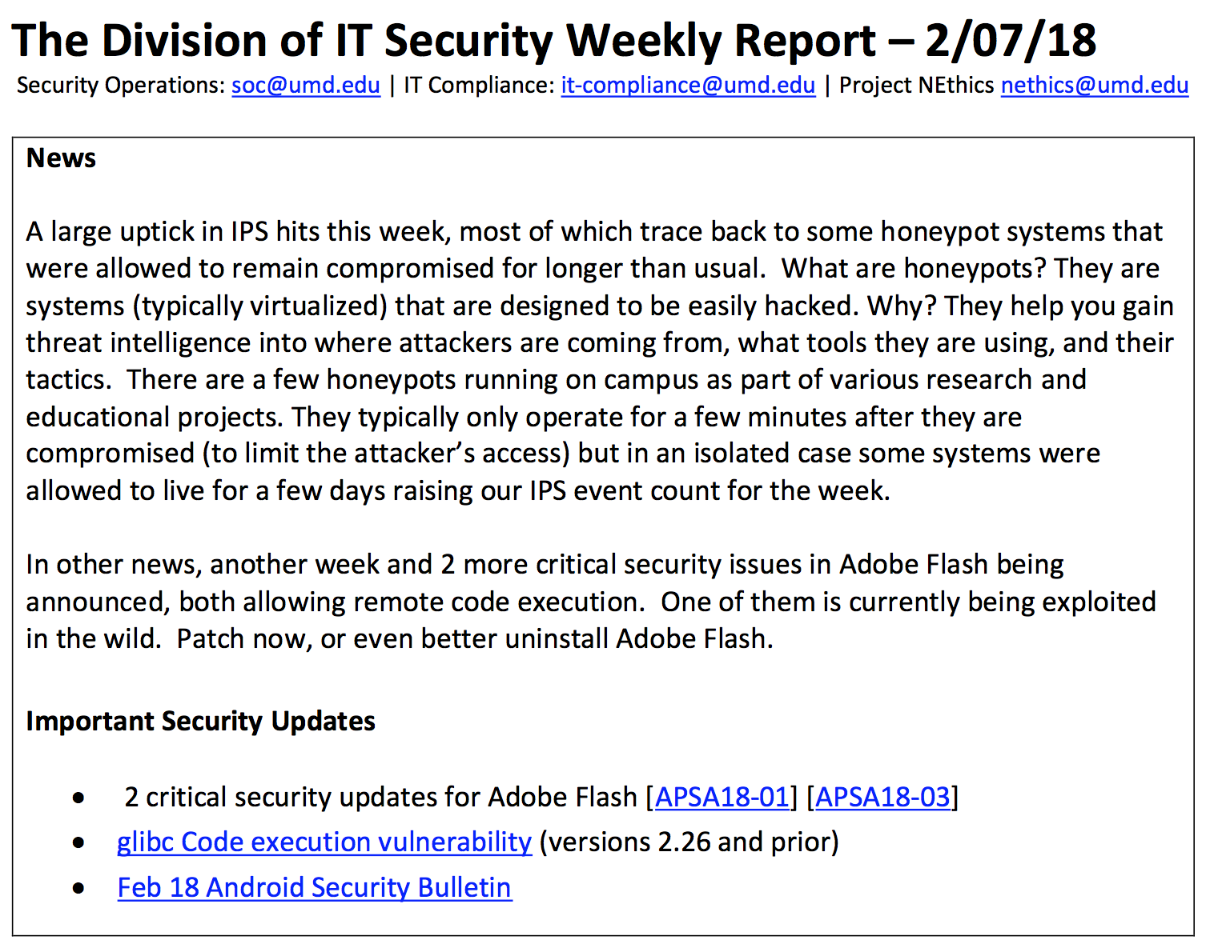

Slide 120
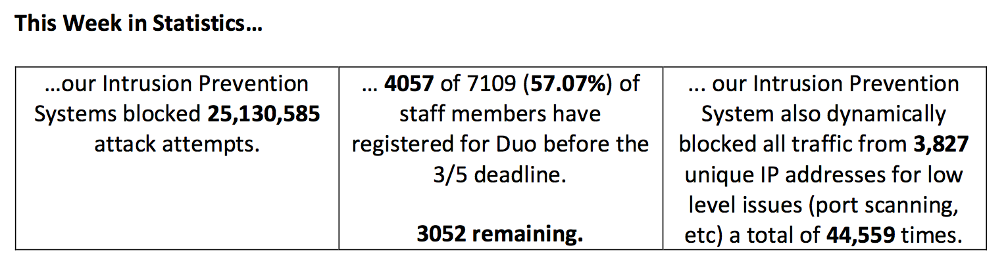
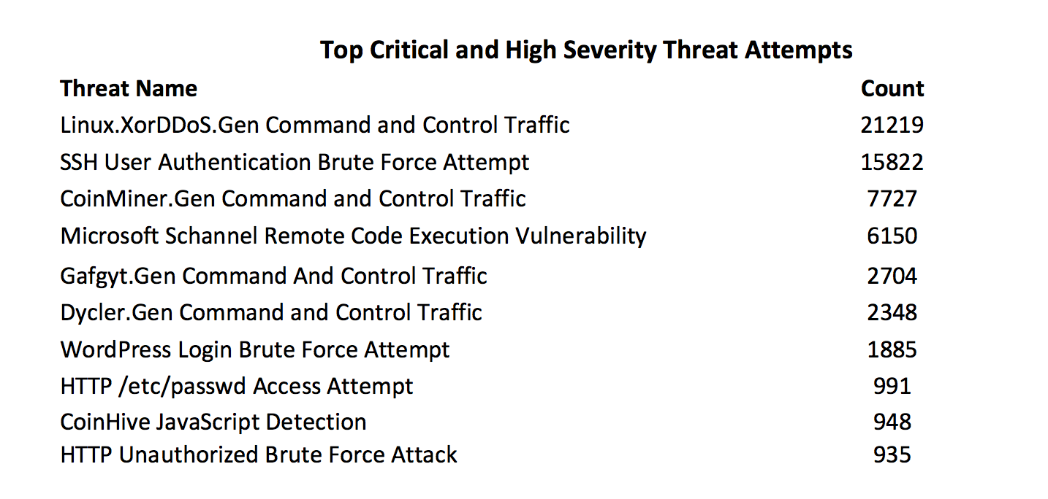

Slide 121
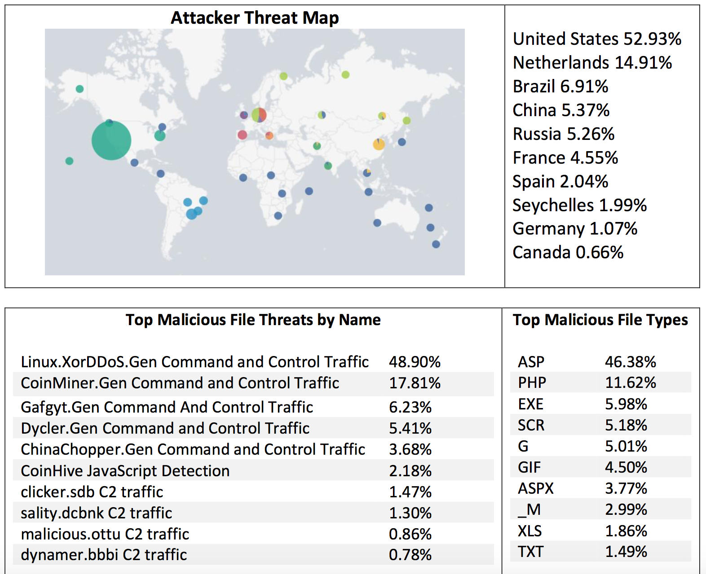

Slide 122
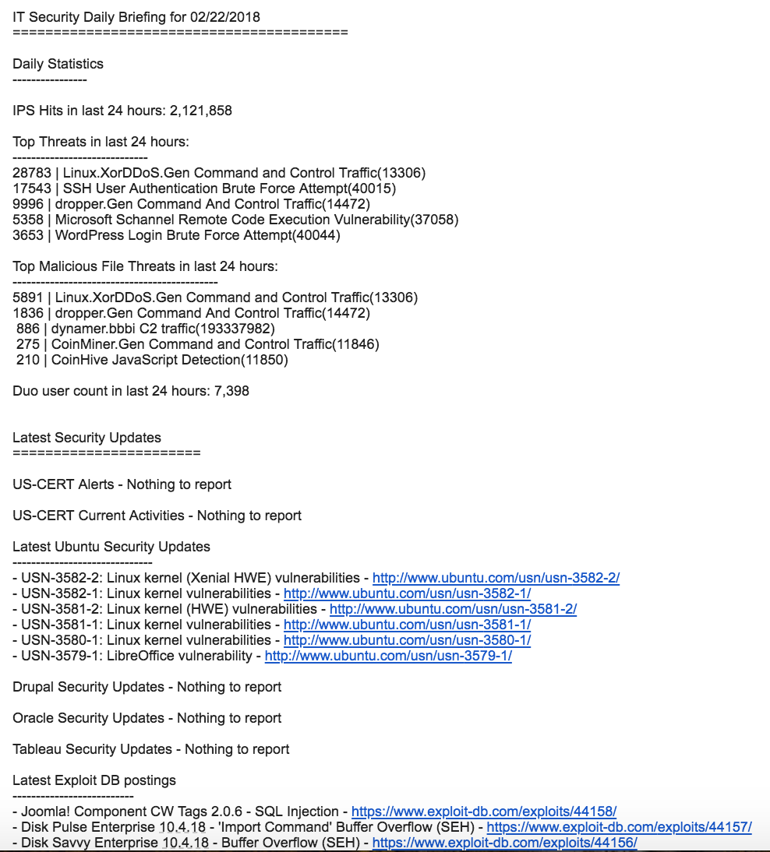

Slide 123
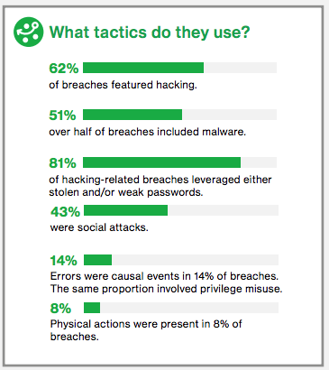
So why all this user talk?
2017 Verizon Data Breach Report
←
←

Slide 124

TIAA’s Cybersecurity Awareness

Slide 125


Slide 126

The Second Best Infosec Tool

Slide 127
Spreadsheets rule!
Sure roll your eyes 🙄 but you would be surprised (and horrified) to see how many business critical functions depend on a spreadsheet with macros/VBA … often running on a Windows 7 machine on someone’s desk 😭

Slide 128
Why Spreadsheets?
Spreadsheets are extremely useful to list, collect, process, determine, and share information
Asset Inventory – what are you trying to protect and where is it?
Useful for comparing lists – how many people have enrolled in MFA and how many still need to?
Sharing data – What systems of group X still need to install our new EDR tool?

Slide 129


Asset Inventory

Slide 130
Asset Inventory
If you don’t know what you are protecting how can you protect it?

Slide 131
Very Important Questions
What systems would prevent our organization from functioning if they were offline?
What systems in the organization process/store sensitive information?

Slide 132
Important Questions
What’s currently exposed to the Internet?
How many total systems do you have?
What software is installed on your systems?
Where is your data?
How many vendors do you have?
Which vendors have what kind of your data?

Slide 133

Offense vs Defense

